Slide 1

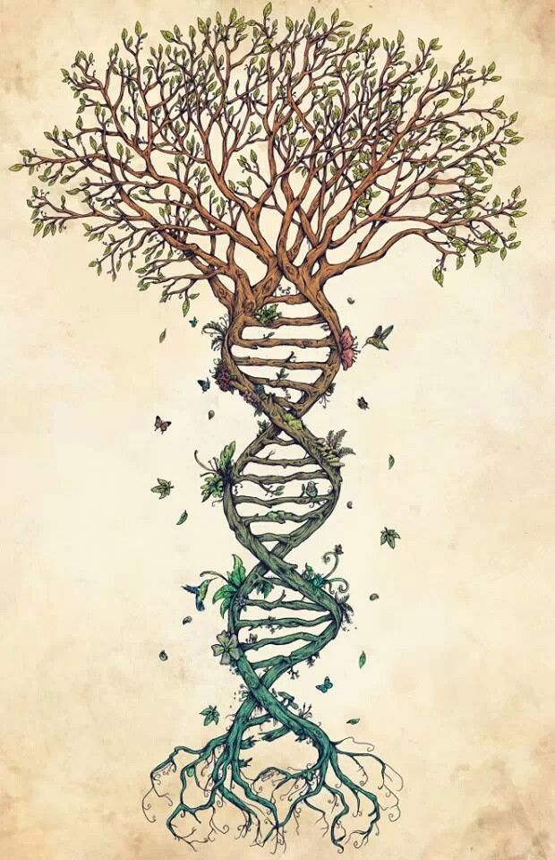
Inferring Phylogenies: BEAST2 and the Protracted Birth-Death model
By Femke Thon & Jolien Gay
Supervisors: Richel Bilderbeek & Rampal Etienne

Slide 2


Research Question
If speciation in nature takes time,
what is the error BEAST2 makes in inferring a phylogeny?

Slide 3
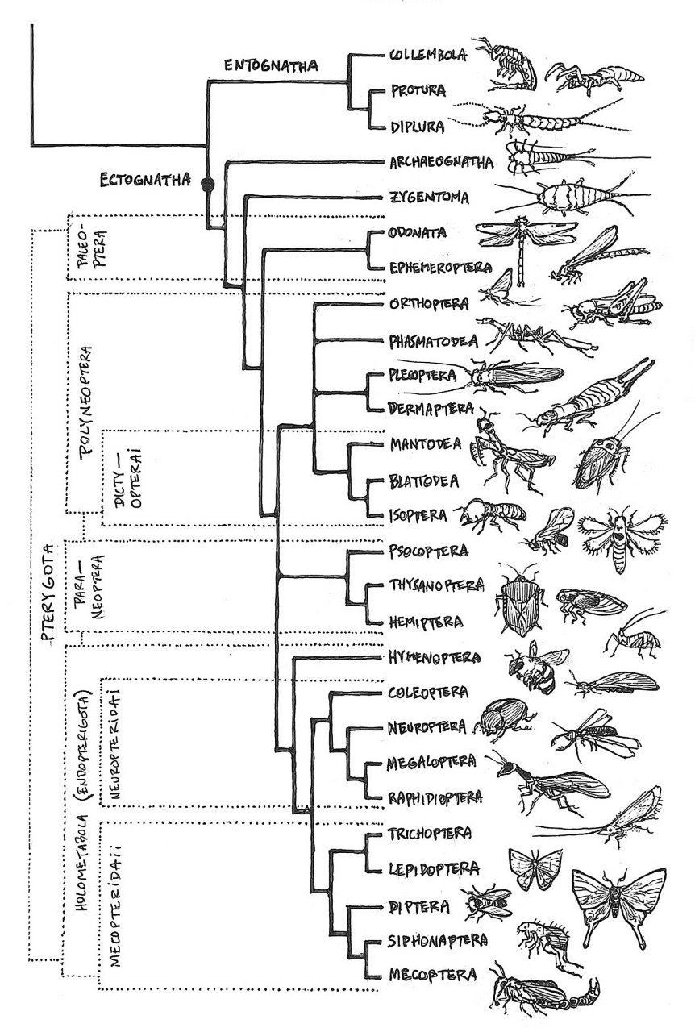
Introduction
Speciation
Evolutionary process
Population -> distinct species (reproductive isolation)
Temporal pattern ??
Phylogenies
Speciation models
Notes:
https://www.reddit.com/r/biology/comments/2t0cgo/a_handdrawn_poster_with_almost_all_insect/

Slide 4
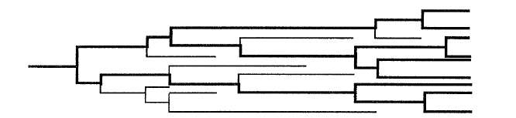
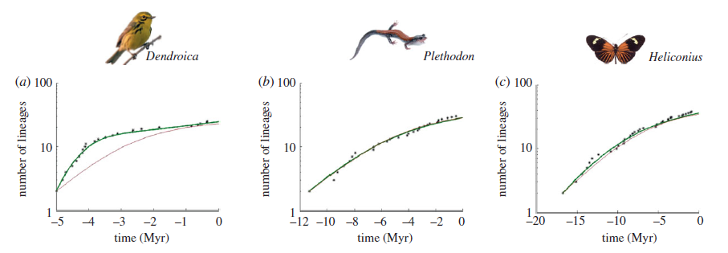
Introduction
Pure Birth-Death model (BD)
Constant speciation and extinction rates
Instant speciation
Number of lineages increase (pull of the present)
BUT: slowdown observed towards the present
Nee Et Al (1994)
Etienne Et Al (2011)

Slide 5
Introduction
Possible explanations:
Sampling artefact
Small sample -> slowdown (Nee et al. 1994b)
BUT: not with complete phylogenies (Phillimore and Price 2008)
Diversity dependence
Slowdown due to niche filling (Ricklefs 2010)
BUT: new species -> new niches (Odling-Smee et al. 2003)
Notes:
Two possible explanations have been proposed to try and explain the observed slowdown
Sampling artifact: 2 artefacts have been found (if a small sample from the actual phylogeny is taken,
BUT: in nearly complete phylogenies, sampling artefact does not explain the observed slowdown
Species-level density dependence: no constants speciation or extinction rates like in the pure BD model. Because of niche filling they will decrease with time.
BUT: new species may create new niches

Slide 6
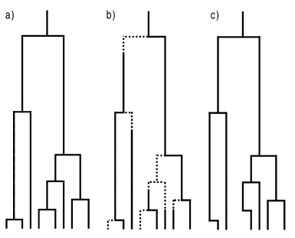
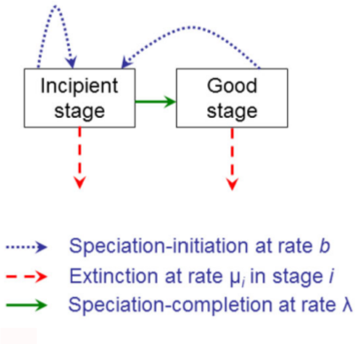
Introduction
Protracted Birth-Death model (PBD)
Extension of BD
Assumes speciation takes time
Assumes two stages
BD | PBD | phylogeny
Etienne and Rosindell (2012)

Slide 7
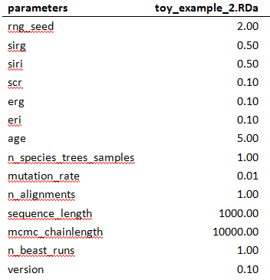
Material & Methods: Start
Important parameters:
Sirg: speciation initiation rate good species
Siri: speciation initiation rate incipient species
Scr: speciation completion rate
Erg: extinction rate good species
Eri: extinction rate incipient species
Age
Mutation rate
Sequence length
Notes:
Example parameter file
- In our research: Around 1000 parameter files
- Age represents total length of tree (we used 5 and 15 MY to illustrate the difference)

Slide 8
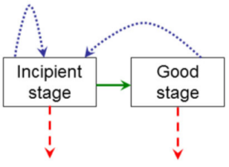
Material & Methods: Start
Important parameters:
Sirg: speciation initiation rate good species
Siri: speciation initiation rate incipient species
Scr: speciation completion rate
Erg: extinction rate good species
Eri: extinction rate incipient species
Age
Mutation rate
Sequence length
Notes:
Example parameter file
- Speciation completion rate

Slide 9
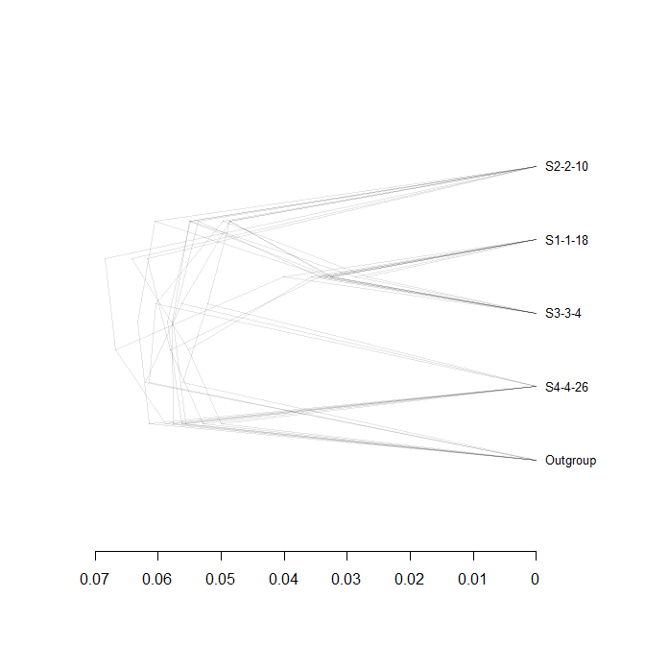
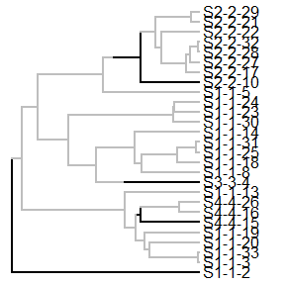

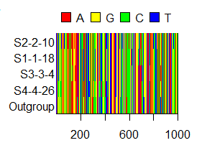
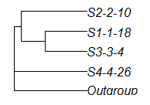
Material & Methods: Workflow
‘true’ tree
posterior
sampled species tree
alignment
Notes:
True tree: 1 per parameter file (around 1000 pmf)
Species tree: 2 per incipient species tree
- Outgroup added to make the phylogenetic inferring software able to root the tree
- BEAST2 assumes a monophyletic species tree (instant speciation -> no multiple individuals / species)
Alignment: 2 per sampled species tree
- 2 BEAST runs per sampled tree
Posterior: 8 posteriors / parameter set (incipient tree)

Slide 10
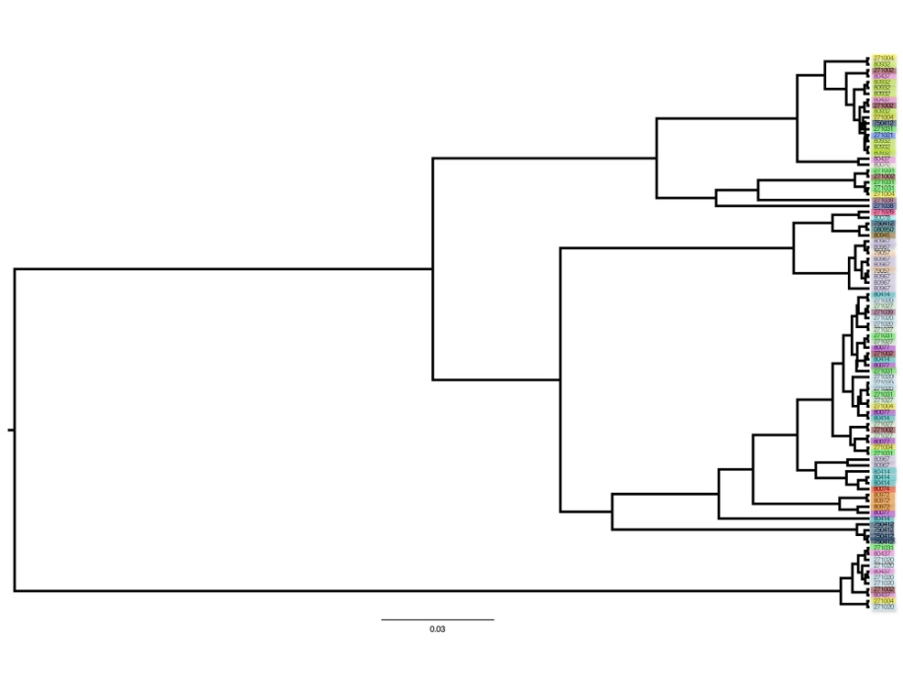
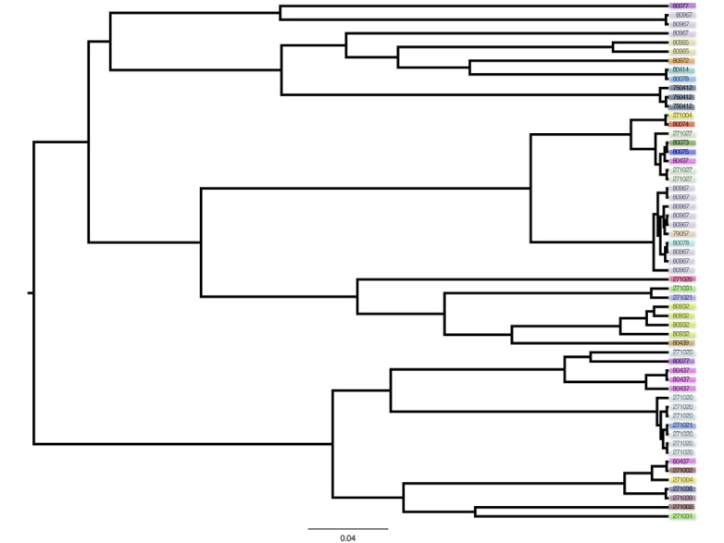
Material & Methods: Analysis
Gamma statistic:
Distribution of branching events within the tree
Tree ‘stemmy’ or ‘tippy’
Compare sampled species tree gammas with posterior trees gammas
Stemmy
Tippy tree
Notes:
?????

Slide 11
Main Question
If speciation in nature takes time,
what is the error BEAST2 makes in inferring a phylogeny?
Sub questions
Can BEAST2 accurately recover a ‘true’ tree?
Error big enough?

Slide 12
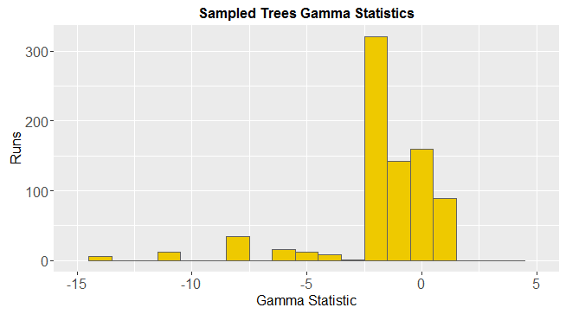
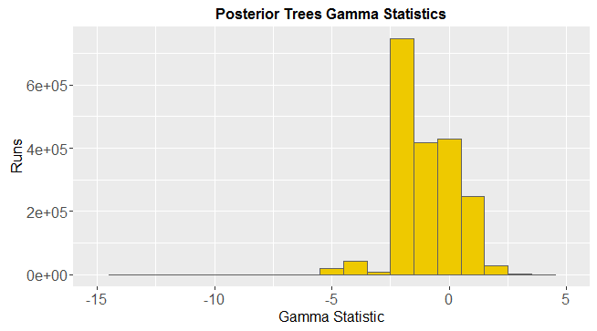
Results: Distribution gamma statistics

Slide 13
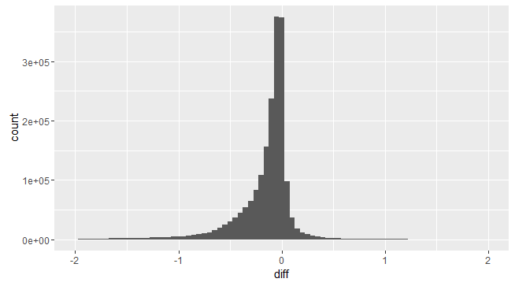
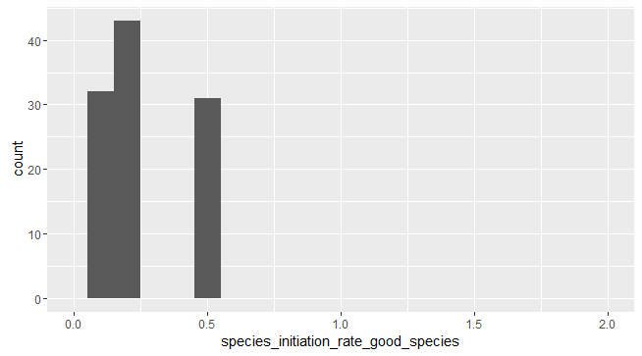
Results: Comparison Gammas
Notes:
Graph 1: The lower the 'comparison' value, the bigger the error of BEAST towards higher gamma statistics.
Interestingly, some parameter values don't show up in the lower comparison values. The higher values for the speciation initiation rate for example (0.8 and 1). This turned to be because of missing posterior gammas for those parameters. All files after ```article_1_5_5_2_2.RDA``` appear to be corrupted.

Slide 14
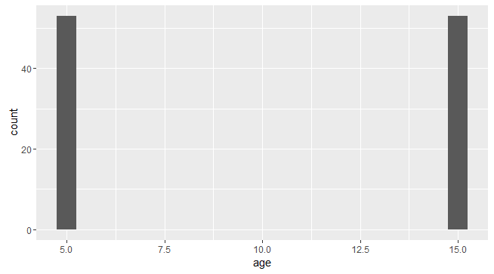
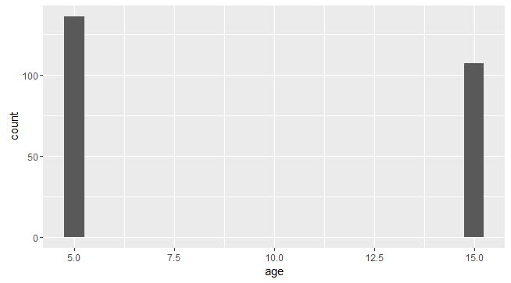
Results: Age
Big difference
Small difference

Slide 15
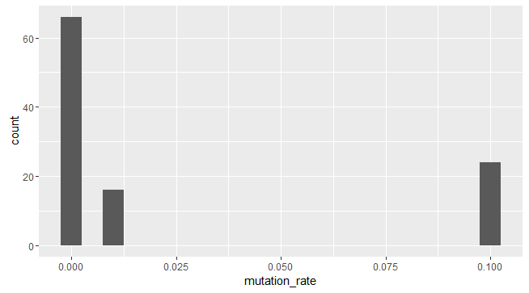
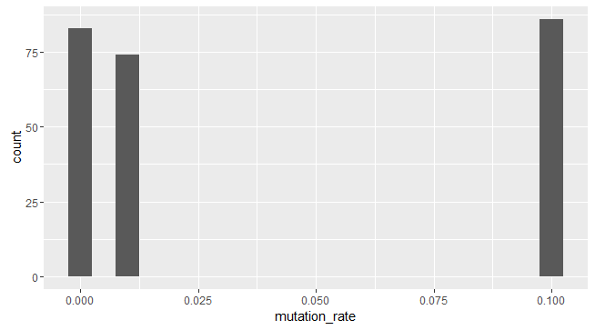
Results: Mutation Rate
Big difference
Small difference

Slide 16
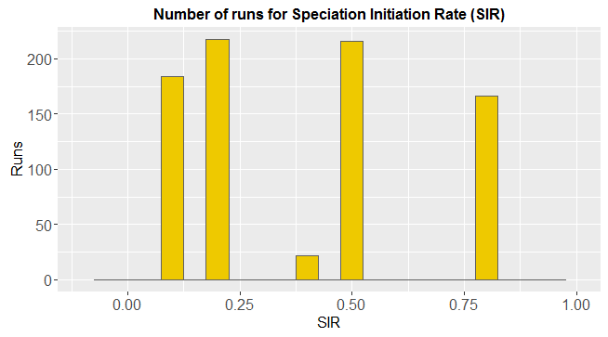
Results: Speciation Initiation Rate (SIR)
Notes:
It seems like there is one parameter which is unusually often present in corrupt files: a species initiation rate of 0.4. For some reason, these are very often corrupted. This is very unexpected, as we’d expect something going wrong with the program if the computer would be overwhelmed by calculations - for example if the speciation initiation rate is high. But high speciation rates seem to be fine:

Slide 17
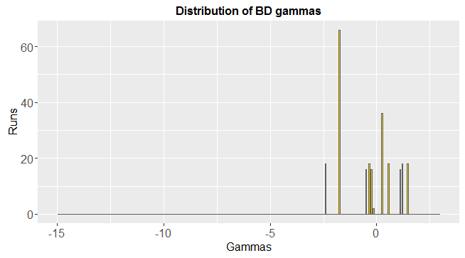
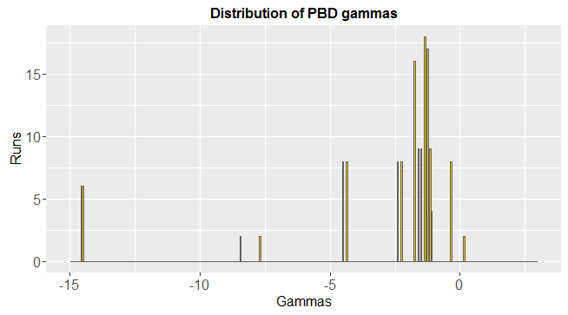
Results: Gamma Distribution

Slide 18
Discussion & Conclusions
Error gamma statistics: substantial

Slide 19

Questions
Notes:
POSSIBLE QUESTIONS?:
Q1: Why did you use an outgroup?
Q2: Are the used summary statistics the best, and why?

Slide 20

BEAST2
Bayesian statistics
MCMC
Multiple speciation models can be applied
All assume instant speciation
Posterior
Prior
Likelihood
Marginal probability

